Slide 1

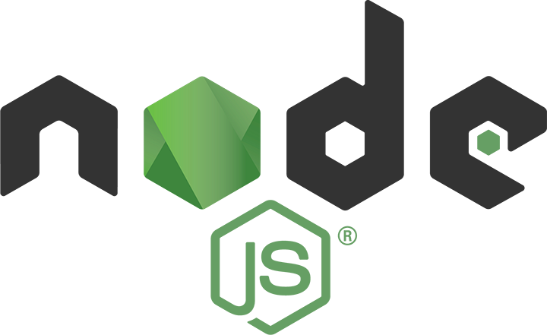
Dev-Pro Node.js
Advanced Flow
Lesson 8. libraries

Slide 2

Agenda:
Servers
ORMs
Useful libraries
Daemons

Slide 3

Why we do not have to invent the wheel.

Slide 4

What's happens with my project

Slide 5

If I’m great inventor?

Slide 6
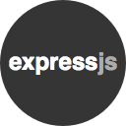
MVC-Frameworks Express.js
Express.js is considered one of the essential web frameworks for Node.js.
It is fast, lightweight and minimal web application framework that offers the robust set of features for building web and mobile applications and APIs.
Express.js is an actively used, maintained and tested framework and offers various features such as database integration, template engines, multiple routing, and much more.

Slide 7

MVC-Frameworks Locomotive.js
Locomotive is a web framework for Node that makes building web applications easier. Locomotive provides strong support for MVC patterns and REST principles, leading to well-architected applications.
Locomotive favors convention over configuration, making developers more efficient.
It does all this without sacrificing any of the power you've come to expect from Node.
Developers coming to Node from other frameworks such as Ruby on Rails will feel immediately comfortable. Rails revolutionized web development, setting the bar by which other frameworks are measured. Locomotive embraces the concepts introduced by Rails, while tailoring them to the idioms of Node.

Slide 8
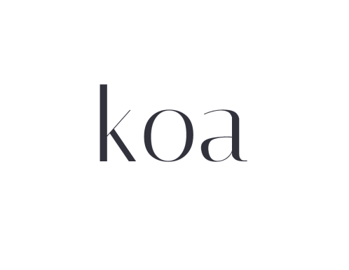
MVC-Frameworks Koa
Koa is a new web framework designed by the team behind Express, which aims to be a smaller, more expressive, and more robust foundation for web applications and APIs.
Through leveraging generators Koa allows you to ditch callbacks and greatly increase error-handling.
Koa does not bundle any middleware within core, and provides an elegant suite of methods that make writing servers fast and enjoyable.

Slide 9

MVC-Frameworks Seneca
Seneca lets you build message based microservice systems with ease.
You don’t need to know where the other services are located, how many of them there are, or what they do.
Everything external to your business logic - such as databases, caches and third-party integrations - is likewise hidden behind microservices.

Slide 10

MVC-Frameworks Adonos
AdonisJs is a Node.js MVC Framework. It encapsulates the boring parts of Web development and offers you a nice API to work with.
Every web application needs following at a certain stage.
Powerful ORM to make secure SQL queries.
Authentication System.
An easy way to send emails.
Validate and Sanitise user inputs.
Structured application layout.

Slide 11

MVC-Frameworks Hapi.js
Strength: Simple, clean design. Performance.
Weakness: Not as many plugins and communities available as some of the competing frameworks.
Great for: Building sites and APIs with a focus on clean code and performance.
The Hapi.js framework is an interesting library that is really clean. I sat down and set up the basic example that is shown on the hapi.js site.
It took a few seconds to install hapi.js and then a few seconds more to create the file, paste in the code, and execute the code.

Slide 12

MVC-Frameworks Mojito
Mojito is a model-view-controller (MVC) application framework built on YUI 3 that enables agile development of Web applications. Mojito allows developers to use a combination of configuration and an MVC architecture to create applications. Because client and server components are both written in JavaScript, Mojito can run on the client (browser) or the server (Node.js).
Local development environment and tools (Yahoo! independent stack)
Library for simplifying internationalization & localization
Integrated unit testing
Device specific presentation (Hero, Mobile, TV, Web, etc.)

Slide 13

Meteor.js Full Stack
Meteor is a full-stack JavaScript platform for developing modern web and mobile applications. Meteor includes a key set of technologies for building connected-client reactive applications, a build tool, and a curated set of packages from the Node.js and general JavaScript community.
Meteor allows you to develop in one language, JavaScript, in all environments: application server, web browser, and mobile device.
Meteor uses data on the wire, meaning the server sends data, not HTML, and the client renders it.
Meteor embraces the ecosystem, bringing the best parts of the extremely active JavaScript community to you in a careful and considered way.
Meteor provides full stack reactivity, allowing your UI to seamlessly reflect the true state of the world with minimal development effort.

Slide 14

Sails.js Full Stack
Sails makes it easy to build custom, enterprise-grade Node.js apps. It is designed to emulate the familiar MVC pattern of frameworks like Ruby on Rails, but with support for the requirements of modern apps: data-driven APIs with a scalable, service-oriented architecture.
It's especially good for building chat, realtime dashboards, or multiplayer games; but you can use it for any web application project - top to bottom.

Slide 15

MEAN.io Full Stack
MEAN is a framework for an easy starting point with MongoDB, Node.js, Express, and AngularJS based applications.
It is designed to give you a quick and organized way to start developing MEAN based web apps with useful modules like Mongoose and Passport pre-bundled and configured.
Framwork mainly try to take care of the connection points between existing popular frameworks and solve common integration problems.

Slide 16
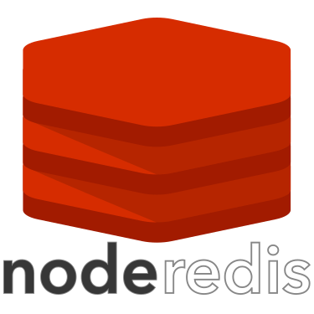

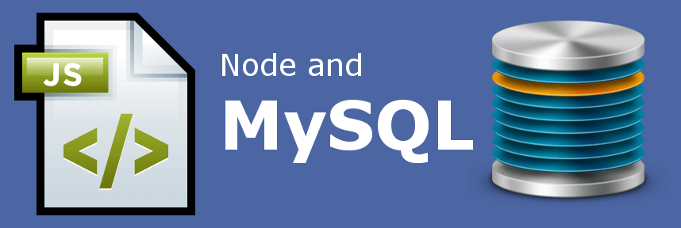
MongoDB, Redis and MySQL

Slide 17

Mongoose
Mongoose provides a straight-forward, schema-based solution to model your application data. It includes built-in type casting, validation, query building, business logic hooks and more, out of the box.

Slide 18
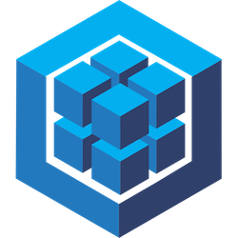
Sequelize
Sequelize is a promise-based Node.js/io.js ORM for Postgres, MySQL, MariaDB, SQLite and Microsoft SQL Server. It features solid transaction support, relations, read replication.
Schema definition
Schema synchronization/dropping
1:1, 1:M & N:M Associations
Through models
Promises
Hooks/callbacks/lifecycle events
Prefetching/association including
Transactions
Migrations

Slide 19


Unit testing : Mocha vs Karma
VS

Slide 20


Unit testing : Jasmine vs Chai
VS

Slide 21

Sockets.io
The JavaScript framework, which leverages Node.js, features an engine module for reliability and supports bidirectional, event-based communication.
Socket.IO arose out of developer Guillermo Rauch's quest to push data from the server to the client without the client requesting it.
"It actually didn't matter what kind of project it was, the need was always there.
This came down to a bigger, fundamental need: speed," Rauch said. Depending on the application, Socket.IO can save dramatic amounts of time in the communication path, he said.

Slide 22

Socketstream
SocketStream is a modular Node.js web framework for building fast, responsive single-page realtime apps.
It provides the structure and basic building blocks you need to create rich social/chat apps, multiplayer games, trading platforms, sales dashboards, or any other kind of web app that needs to display realtime streaming data.
Sane structure for client & server
Sensible defaults (Think Rails convention over configuration)
Live Reload while developing
Asset packing and CDN support
Modular client-side JavaScript
Integrates well with popular client-side frameworks (e.g. Backbone, Ember, Angular)

Slide 23

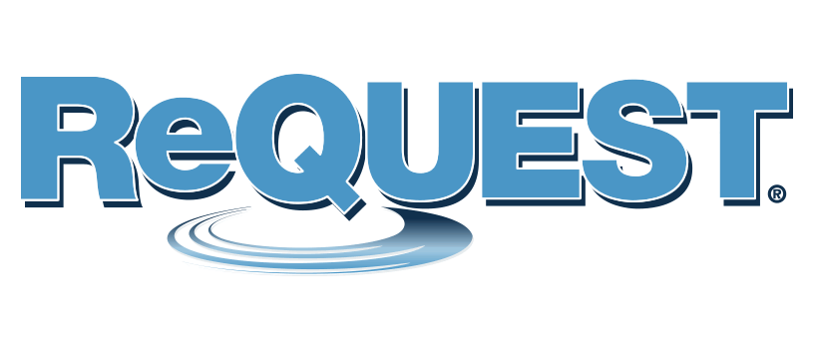

E2E, Request, Frisby

Slide 24

Passport.js
Passport is authentication middleware for Node. It is designed to serve a singular purpose: authenticate requests. When writing modules, encapsulation is a virtue, so Passport delegates all other functionality to the application. This separation of concerns keeps code clean and maintainable, and makes Passport extremely easy to integrate into an application.
In modern web applications, authentication can take a variety of forms. Traditionally, users log in by providing a username and password. With the rise of social networking, single sign-on using an OAuth provider such as Facebook or Twitter has become a popular authentication method. Services that expose an API often require token-based credentials to protect access.

Slide 25
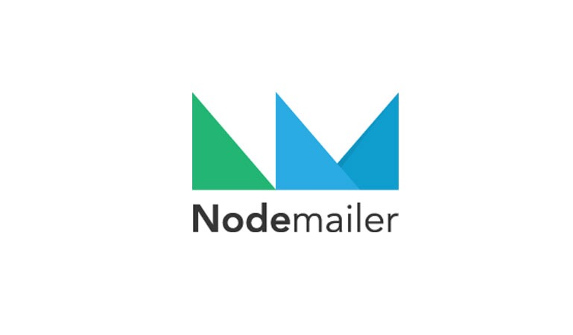
Nodemailer
Nodemailer is an easy to use module to send e-mails with Node.JS (using SMTP or sendmail or Amazon SES) and is unicode friendly
Nodemailer supports
Unicode to use any characters
HTML content as well as plain text alternative
Attachments (including attachment streaming for sending larger files)
SSL/STARTTLS for secure e-mail delivery
Different transport methods - SMTP, sendmail, Amazon SES or directly to recipients MX server or even a custom method
SMTP Connection pool and connection reuse for rapid delivery
Preconfigured services for using SMTP with Gmail, Hotmail etc.

Slide 26

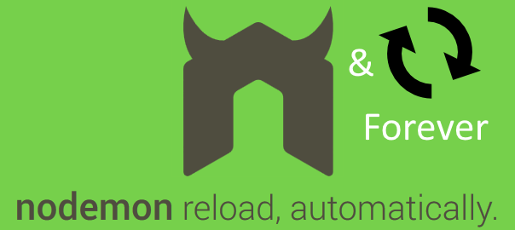

Forever, Daemonize

Slide 27

Why we have to know about this?

Slide 28

About presenter
Nick Lototskiy
Engineering Lead at Dev-Pro.net
nick.lototskiy@gmail.com

